Slide 1
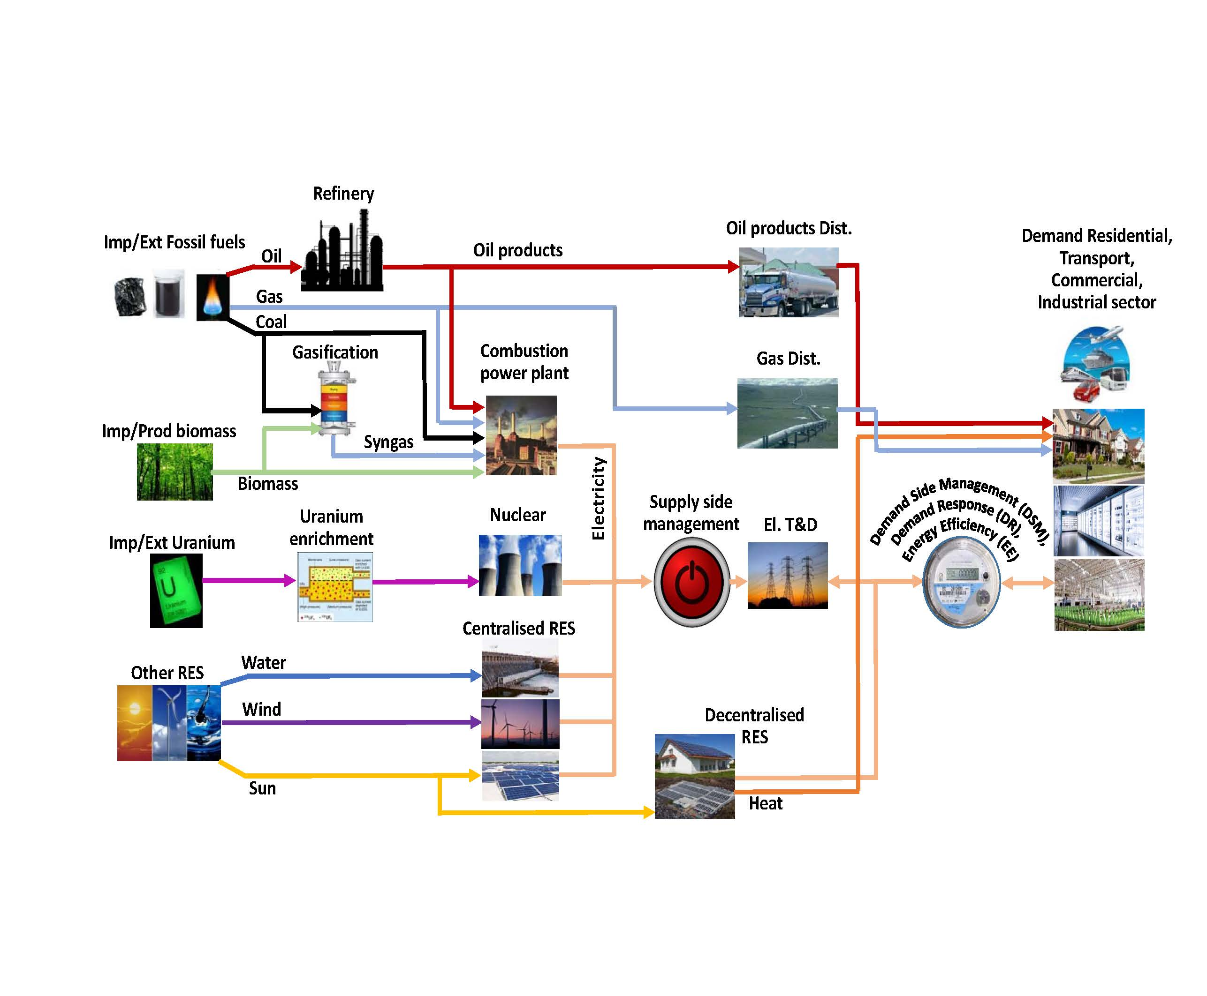
Energy system
Complex system including numerous supply chains linking energy resources to final energy demands.

Slide 2
Energy system
Complex system including numerous supply chains linking energy resources to final energy demands.
Resources
Final demands

